Slide 1
组会汇报
汇报人：王子晨

Slide 2


文献

Slide 3
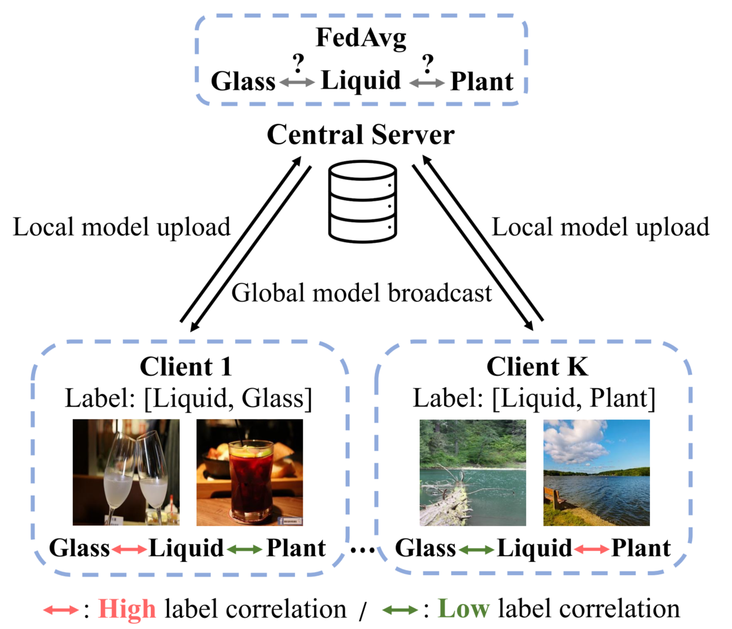
Challenges in multi-label federated learning.

Slide 4



A Brief Review for C-tran

Slide 5
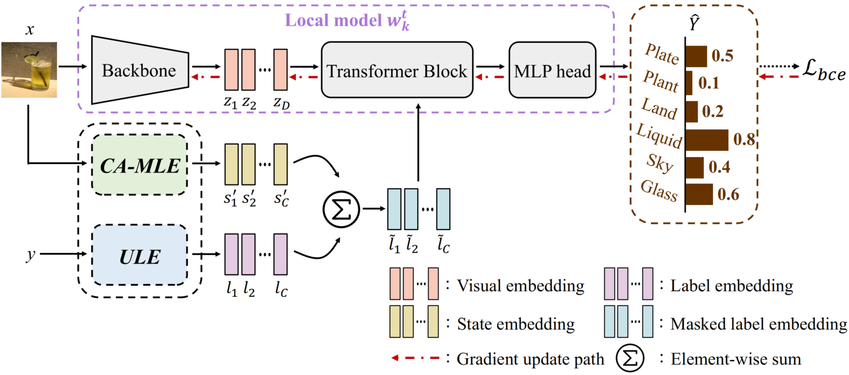
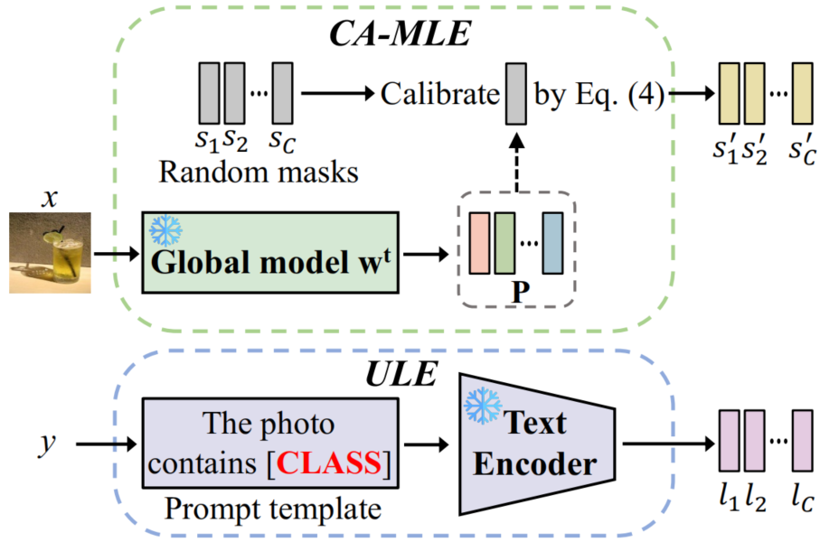

FedLGT

Slide 6
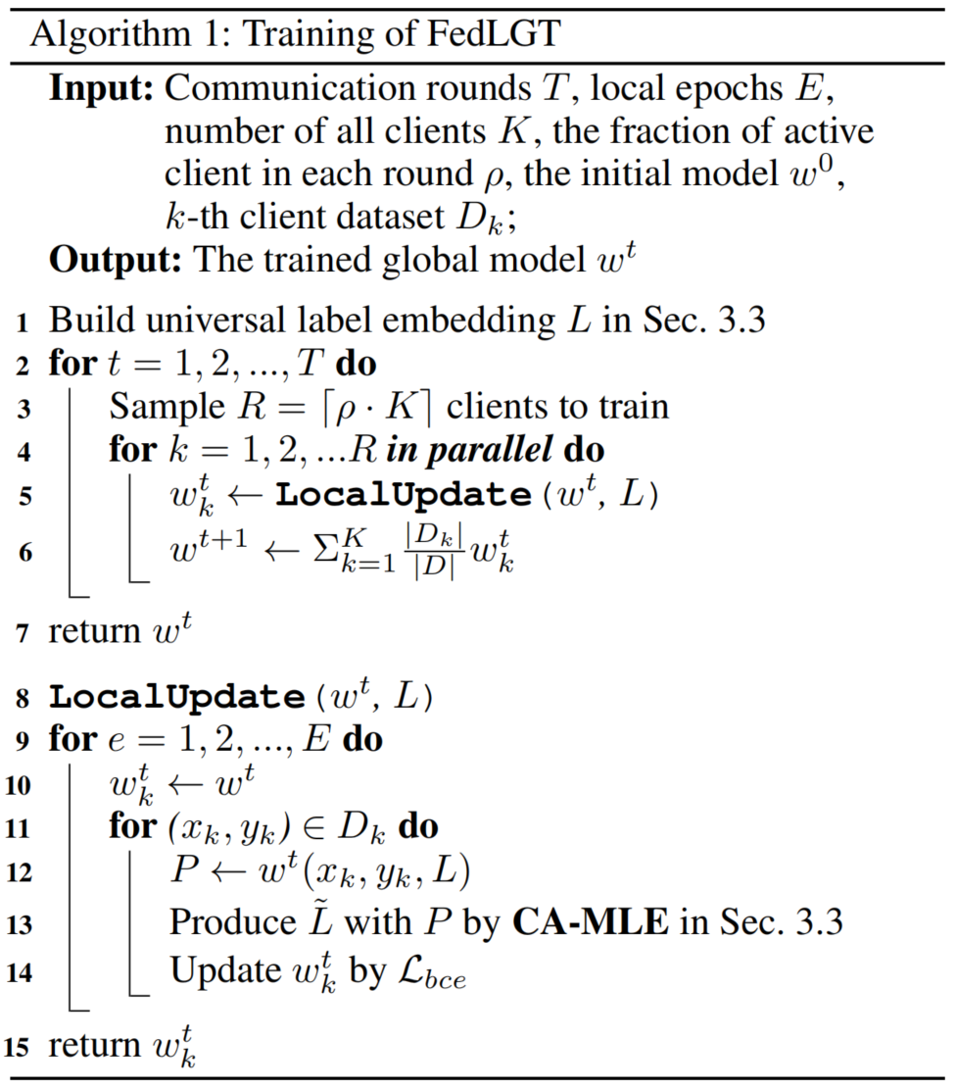

Slide 7
Thanks

